Slide 1



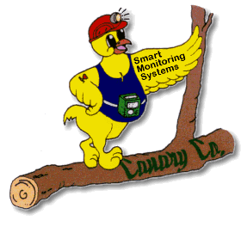
Gas Detection Training
MSR
Canary
Austech
Gastech

Slide 2
Brief Intro to Units!
PPM
Parts per Million, exactly what it sounds like!
For example if you have 2g of CO2 in a 1kg bottle of air. How many parts per million of CO2 would be in the bottle?
PPK
Parts per thousand is just parts per million * 1000.
Similar example if you have 2g of CO2 in 1kg bottle of air. How many parts per thousand of CO2 would be in the bottle?
Additional note: PPM / PPK doesn’t actually measure parts it’s a volume fraction.

Slide 3
Intro to Units %VOL
%VOL (Percentage Volume) (0-100% Vol)
Refers to the fraction of air that is occupied by the gas.
For example:
If 5% Vol CO2 is in the air, CO2 makes up 5% of the volume of air.
Note:
If 5% Vol of CO2 is in the air, it is equivalent to 50,000 ppm of CO2. This is a conversion valid for all gases (even though it is an estimation).
Exercise:
If a CO2 gas detector is reading 0.4%Vol in a room with a volume of 55m^3 what is the CO2 reading in ppm.

Slide 4
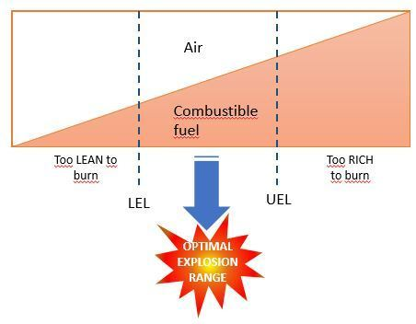
Intro to Units % LEL
LEL is referred to as the lower explosive limit (AS 60079.2)
Sometimes referred to as Lower Flammable Limit
UEL is referred to as the upper explosive limit (AS 60079.2)
Sometimes referred to as Upper Flammable Limit
Concentration of Explosive Gas Vs Air

Slide 5
Lower Explosive Limits (AS 60079)
Lower explosive limits are defined by AS 60079.20.1-2012
Methane:
4.4% VOL = 100% LEL
Hydrogen:
4.0% VOL = 100% LEL

Slide 6
IECEx vs. ATEX
IECEx is a certification that requires adherence to IEC/AS 60079.
IECEx requires recertification and quality management in manufacturing to the point where recertification every few years is required. ISO Type 5 certification this means spot checks for conformance is performed and any changes to manufacturing and end product require recertification.
ATEX is not a ISO Type 5 certification, thereby once certification is acquired the manufacturing conformance and end product modifications are not verified by certification body.

Slide 7
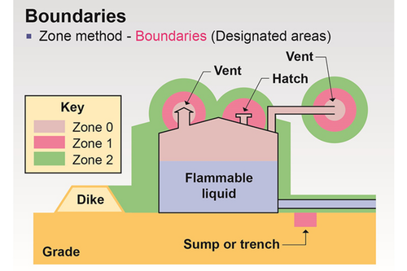
Hazardous Area Standard AS 60079 (Note: Gas Only)
Hazardous gas sensors are made for 3 types of zones (IEC 60079-10.1). Each reflecting the maximum likelihood of flammable gas.
Zone 0: Explosive gas atmosphere present 1000 hrs / year. (>10% of time in service)
Zone 1: Explosive gas atmosphere present 10-1000 hrs /year (1-10% of time in service)
Zone 2: Explosive gas atmosphere present <10 hrs / year (0-0.1% of time in service)
Note: Boundaries and zones should come clearly labelled by consultants.
Most often they are not clearly labelled.

Slide 8
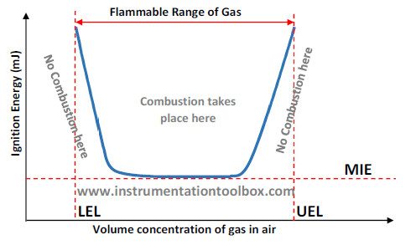
Hazardous Area Standard AS 60079 Cont. (Selection of Equipment)
Few things to consider:
Minimum Ignition Energy
Auto Ignition Temperature (VERY IMPORTANT)
Type of gas being detected.
T Rating (Found by using the Auto Ignition Temperature)
Equipment Protection Levels (Zone 0 / Zone 1 / Zone 2)
IP rating required (if explosion protected IP rating shall be sufficiently high)

Slide 9
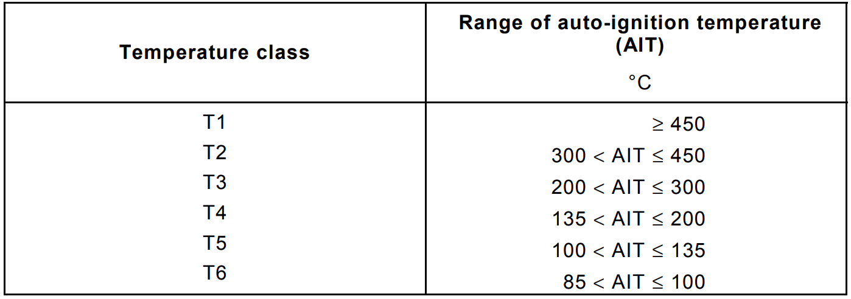
Hazardous Area Standard AS 60079 Cont. (Selection of Equipment)
Auto Ignition Energy is a measure of the maximum temperature allowed in the hazardous area.
For Example CS2 (carbon disulfide) has a auto ignition temperature of 85 C, which means if the surface temperature of any equipment in the room reaches 85 C there is a danger of spontaneous combustion.
Using the auto ignition temperature in AS 60079.20 & 60079.14 we can select the appropriate gas sensor & conduit / wire to use in the zone rated area.
Note: When selecting the sensor (given no T class rating) take into consideration the ambient temperature (Default ambient is -20 to 40C ). If ambient temperature in install location is higher adjust T class to compensate. Furthermore for a specified auto ignition temperature between 300-450 C therefore a Temperature class of T2-T6 is appropriate.

Slide 10
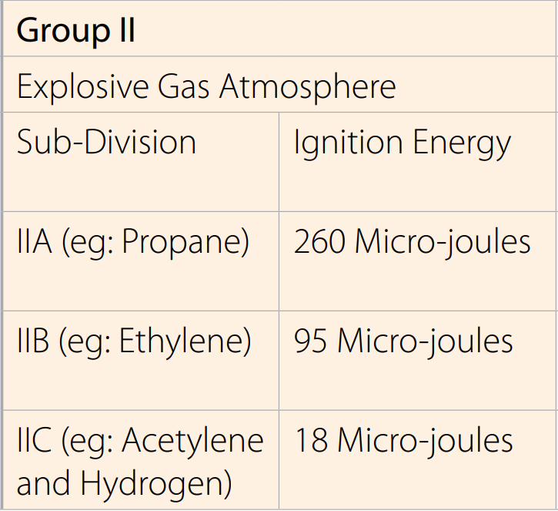
Hazardous Area Standard AS 60079 Cont. (Selection of Equipment)
Gas Group, Gases are classed into 3 categories A, B , C.
These can be determined using AS 60079-20 by looking up the gas in Annex B.
Ignition energy is the MIE shown.
If sensor or equipment requirement is IIA which of the sub-divisions are suitable?

Slide 11
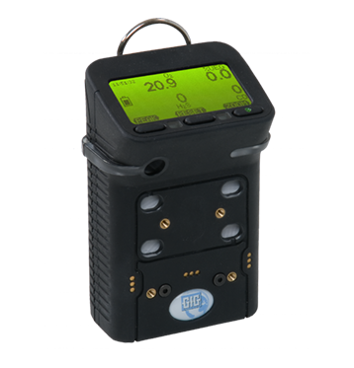
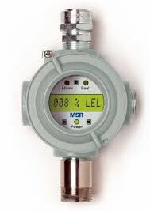
Hazardous Area Standard AS 60079 Cont. (Equipment protection level)
Types of Protection
Intrinsic Safety {Ex i}
A circuit designed in order to produce sparks or thermal effects which lie below the minimum ignition energy.
Increased Safety Enclosure {Ex e}
Increased safety specification inhibits arcs or sparks from forming in normal operation. Generally used for junction boxes or lighting fittings.
Flame proof Enclosure {Ex d}
Flameproof enclosures ensure that any flame generated by electronics inside of the housing cannot spread to the outer atmosphere.

Slide 12
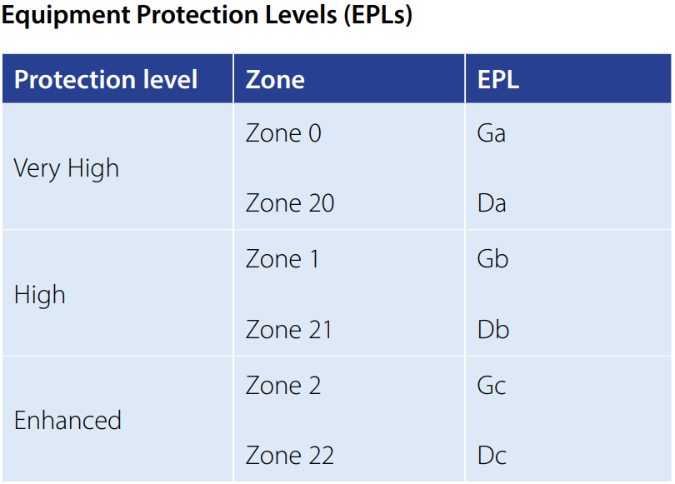
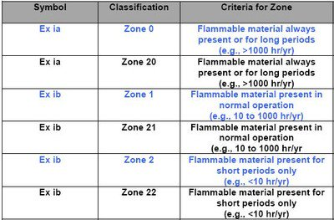
Hazardous Area Standard AS 60079 Cont. (Equipment protection level)
EPL:
Equipment Protection Levels are designated by the hazardous goods consultant. These should be supplied as either a zone or a EPL value as shown in table below.
Equipment Classification:
Used as a method of differentiating the EPL along with protection method.
Note:
G stands for Gas
D stands for Dust
Similar designation for Ex da/db/dc and so on.

Slide 13
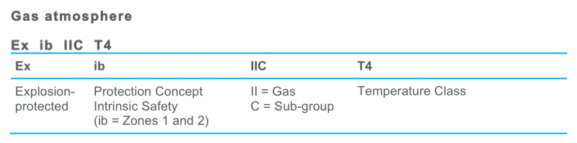
Hazardous Area Standard AS 60079 Cont. (Putting it all together)
Exercise:
Determine a suitable component to meet the specifications below:
Zone 1
Auto Ignition temperature of 365C
Hydrogen gas detector (Gas Group B)
Ambient temperature = -30 to 60C
Gas Detector A
EX db IIB T5
Gas Detector B
EX da IIC T6
Gas Detector C
EX da IIC T1

Slide 14
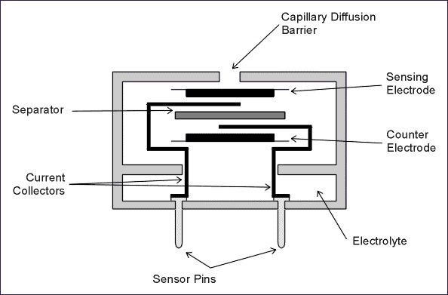
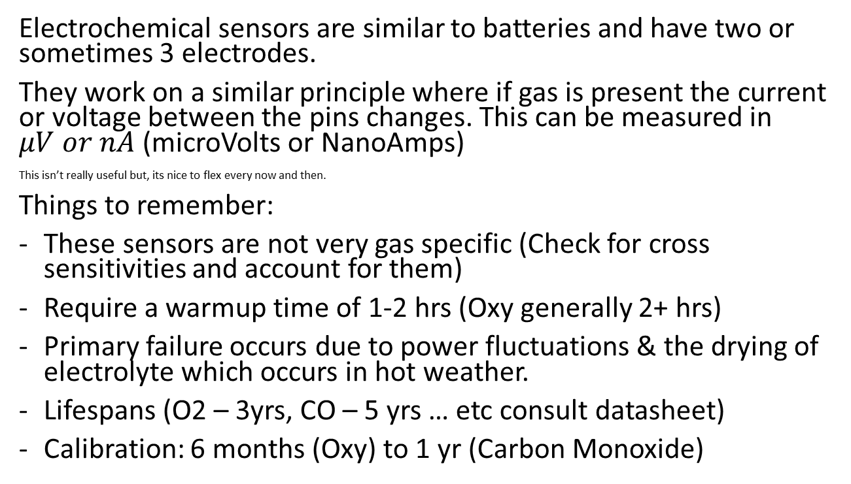
Types of Sensors – Electrochemical sensors
Electrochemical sensors are similar to batteries and have two or sometimes 3 electrodes.
They work on a similar principle where if gas is present the current or voltage between the pins changes. This can be measured in $μV or nA$ (microVolts or NanoAmps)
This isn’t really useful but, its nice to flex every now and then.
Things to remember:
These sensors are not very gas specific (Check for cross sensitivities and account for them)
Require a warmup time of 1-2 hrs (Oxy generally 2+ hrs)
Primary failure occurs due to power fluctuations & the drying of electrolyte which occurs in hot weather.
Lifespans (O2 – 3yrs, CO – 5 yrs … etc consult datasheet)
Calibration: 6 months (Oxy) to 1 yr (Carbon Monoxide)

Slide 15
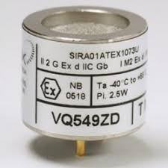
Types of Sensors – Pellistor or Catalytic sensors
Catalytic bead or Pellistor sensors work on the principle that the gas being detected is flammable.
Things to remember:
Not very gas specific (methane sensors will detect hydrogen and vice versa)
Works on almost all explosive gases, however some special explosive gases require special filters, which means the regular sensorcells will not work on these types of gases and a specific sensor is required.
Pellistor sensors can be directly affected by the humidity and water splashes. This may result in a sensor reading higher than ambient gas levels.
Primary failure occurs due to silicon poisoning. DO NOT USE SILICON ANYWHERE NEAR THESE!!!!
Lifespan: 5+ years
Calibration Requirements: 6 monthly calibration

Slide 16
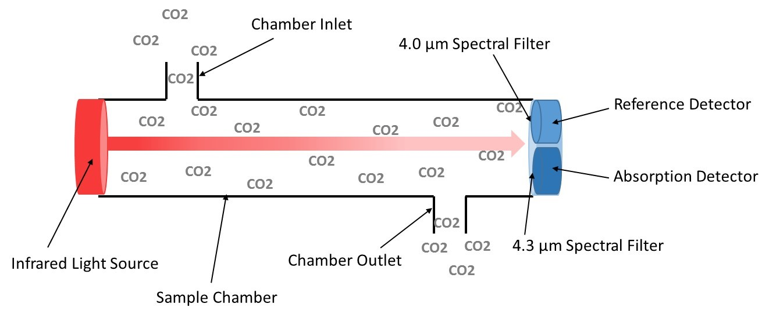
Types of Sensor – Infra-red
Infra-red Sensor detect gases because CO2 and other gases can absorb Infra-red light at a certain wavelength. Due to this specific property only certain gases are available with infra-red detection cells.
Things to remember:
Infra-Red sensors are very specific and very accurate.
Primary failure will occur due to dust ingress or electrical circuit failure due to power spikes.
Lifespan: 7+yrs (This value is conservative, it’s likely longer)
Calibration: Explosive infra-red (1 YR), CO2 (1 YR)
Bump test: Every 6 months (check whether they respond)

Slide 17
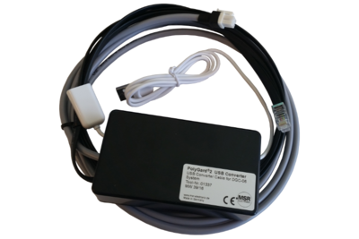

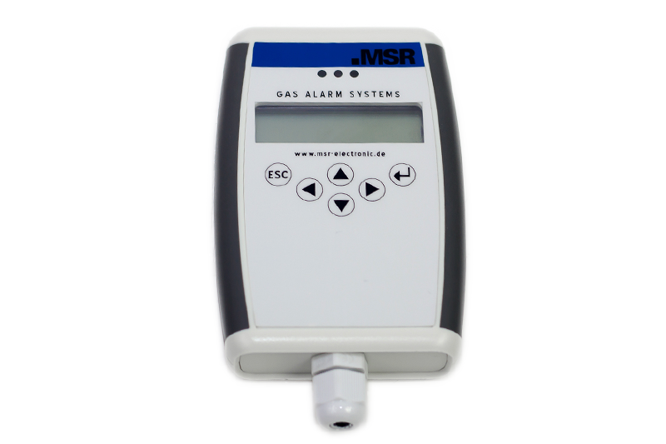
Calibration Tool Kit Essentials
Tools Required:
Essentials:
Gas Regulator
Sensor cap (to ensure good seal between calibration gas and sensorhead)
Flexible hose (2m length 8mm OD)
Multimeter with leads for alligator clips
Gas Bottle 1:
18.5% Vol Oxygen
Bal. N2
Gas Bottle 2:
Mix Gas:
2.5% Vol CH4
100 ppm CO
18% Vol Oxygen
4% Vol CO2
Bal. Air / N2
Gas Bottle 3:
99.999% Vol N2

Slide 18
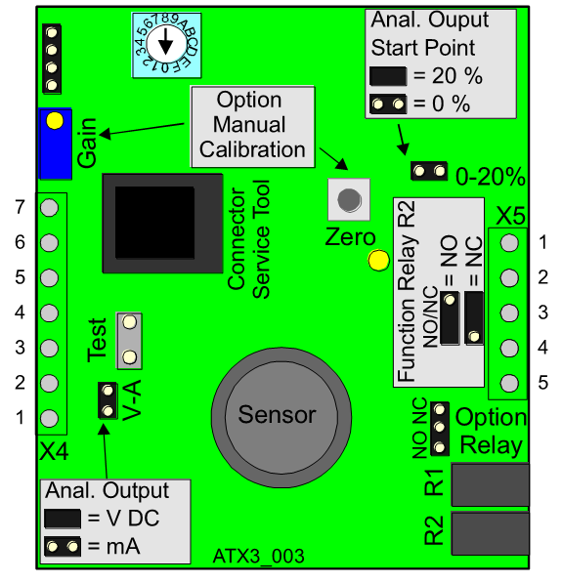
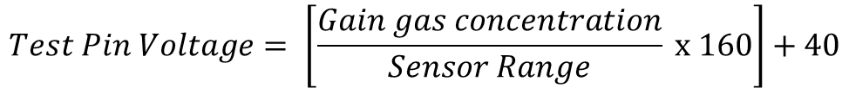
Calibration of MSR Infra-red & Electrochemical Sensors
Step 1: Engage Service mode (To inhibit alarm when calibration gas is applied)
Step 2: Apply multi-meter to Test Pins
Step 3: Apply Zero calibration gas to sensor (wait 30 seconds)
Step 4: Check multi-meter reading. At Zero gas value it should read 40mv. If it requires adjusting Pull board out and plug back in. Hit the zero button multiple times until the multi-meter is reading 40mv.
Step 5: Remove zero calibration gas and apply Gain calibration gas (wait 30 seconds, Consult datasheet for t90 to decide on appropriate waiting time)
Step 6: Adjust gain calibration pot till given value is equivalent in mv to the following equation.
$$Test Pin Voltage= \left[\frac{Gain gas concentration}{Sensor Range} x 160\right]+40$$

Slide 19
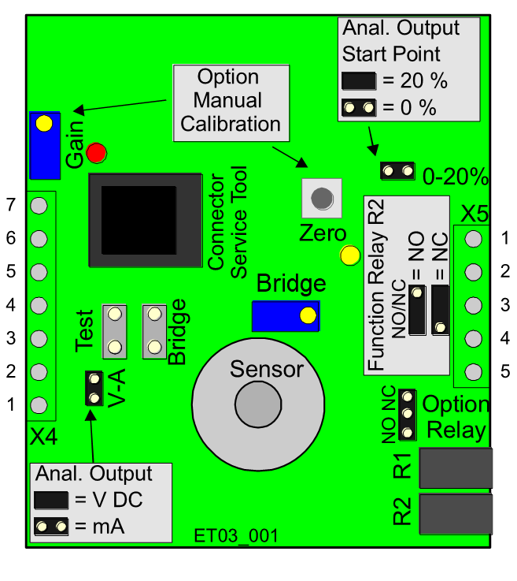
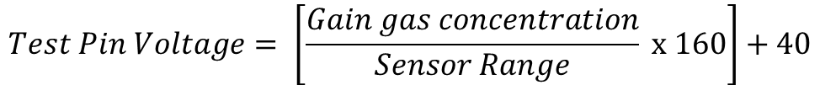
Calibration of MSR Pellistor sensors
Step 1: Engage Service mode (To inhibit alarm when calibration gas is applied)
Step 2: Apply multi-meter to Bridge Pins
Step 3: Apply Zero calibration gas to sensor (wait 1 minute for sensor reading to stabilize).
Step 4: Adjust Bridge Voltage to 0 mv (slightly above 0 mv is recommended ~0.1mv).
Step 5: Apply multi-meter to test pins.
Step 6: At Zero gas value it should read 40mv. If it requires adjusting Pull board out and plug back in. Hit the zero button multiple times until the multi-meter is reading 40mv.
Step 7: Remove zero calibration gas and apply Gain calibration gas
Step 8: Adjust gain calibration pot till given value is equivalent in mv to the following equation.
$$Test Pin Voltage= \left[\frac{Gain gas concentration}{Sensor Range} x 160\right]+40$$

Slide 20
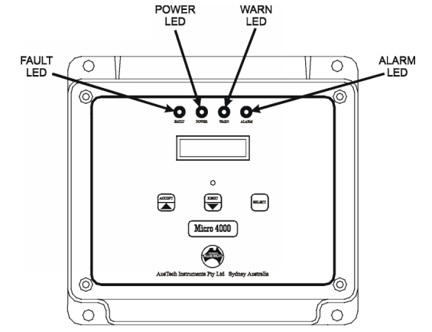
Adjustment of AUSTECH Sensor System
Step 1: Cycle to sensor to be calibrated
Step 2: Apply zero gas
Step 3: Enter Calibration mode by using the Accept and Select Buttons together for 5 seconds. (Countdown shown shall be CAL 5, 4, 3… 1 if LCD displays SET, abort and ensure accept and select buttons are used.)
Step 4: Adjust sensor reading on LCD to 0 reading.
Step 5: Apply gain gas
Step 6: Adjust sensor reading on LCD screen to match the gain calibration gas concentration.
Accept
Reset
Select

Slide 21
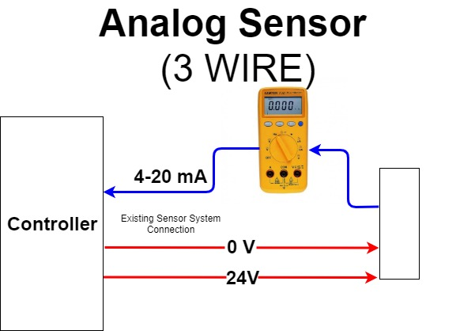
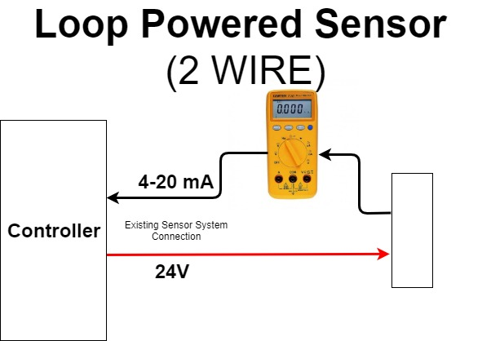
Calibration of AUSTECH Sensor System
Sensor
Sensor
Step 1: Apply zero gas and adjust sensor output using zero pot
Step 2: Apply gain gas and adjust sensor output using gain pot

Slide 22
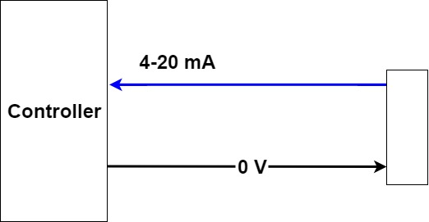
Calibration of AUSTECH Sensor System Continued…
Step 1: Apply 4ma through the current generator
Step 2: Scroll to sensor being calibrated and hold down “Accept” and “Select” buttons
Step 3: Adjust sensor reading to 0
Step 4: Apply 20 ma through the current generator
Step 5: Adjust sensor reading to full range (ie. 25% for oxygen or 100% LEL for methane)
Note: Find the connection points on HOSLAB Server – “L:\Manuals\Austech\”
mA Current Generator

Slide 23
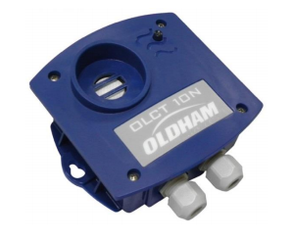
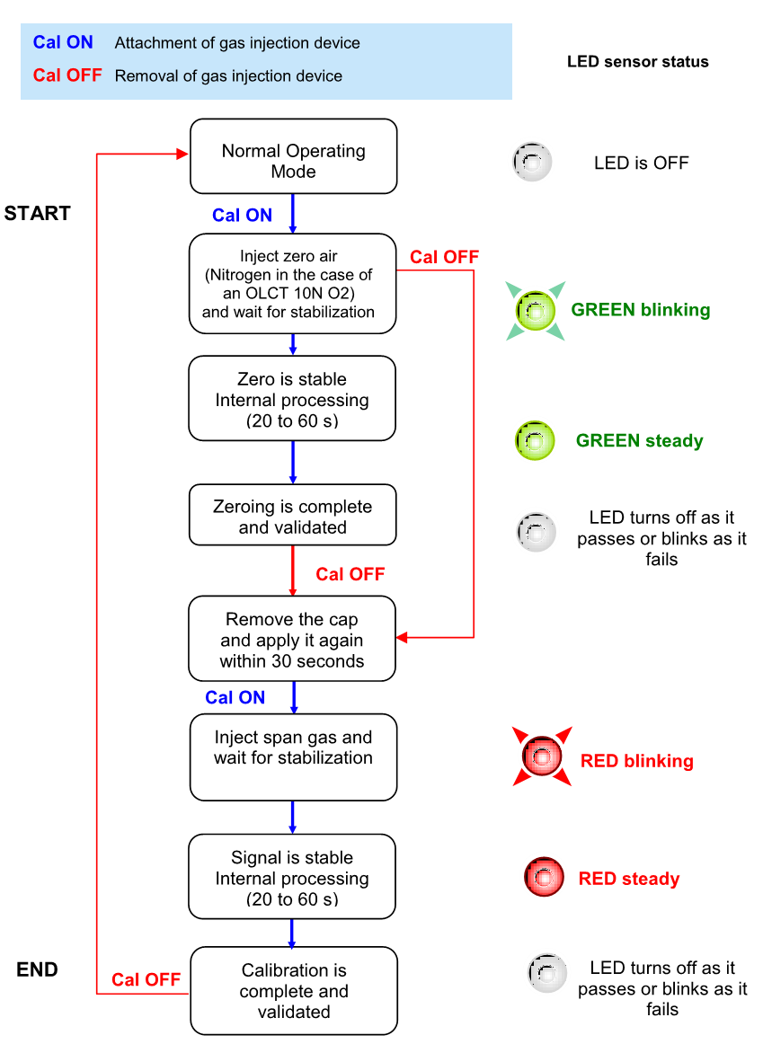
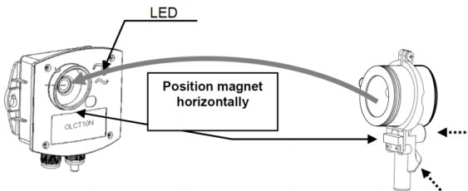
OLDHAM OLCT-10N Auto-Calibration
Cal ON refers to applying the calibration cap below

Slide 24
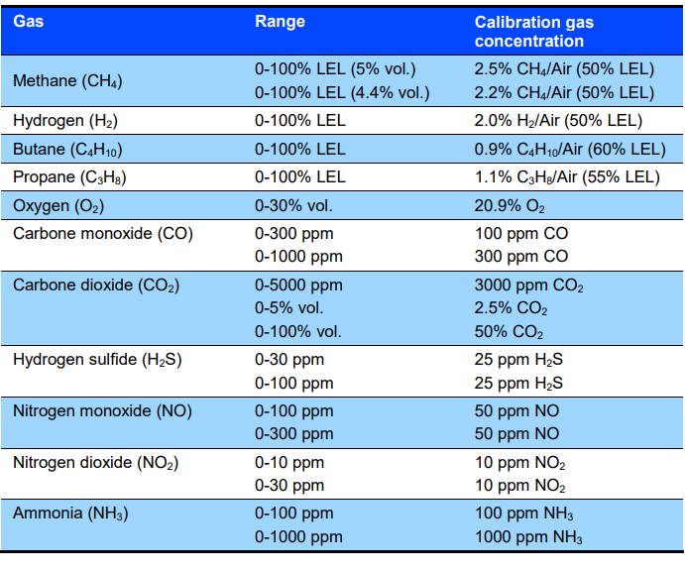
OLDHAM OLCT-10N Auto Calibration – Cont.
Calibration Gas Concentration can’t be adjusted. If you don’t have the correct gain gas perform manual calibration (bit more effort)
Common Sensor Replacements (Suitable types):
Alphasense O2-A2 only work for this
If LEL sensor, replace the entire sensor as no replacement sensor cell available

Slide 25
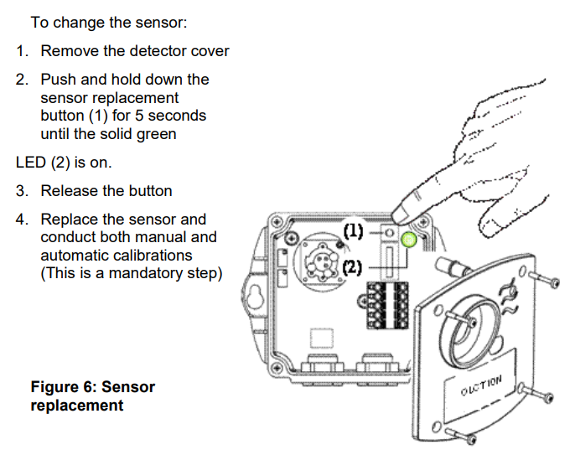
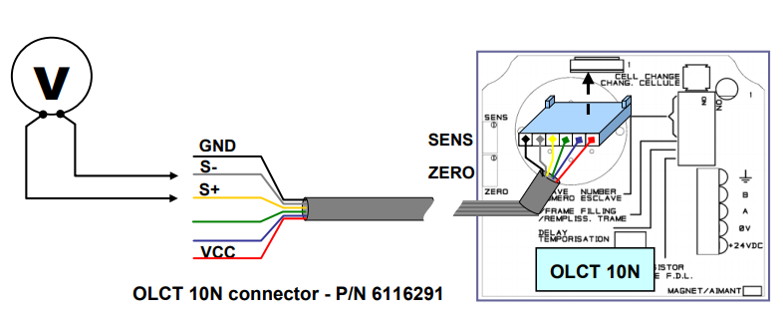

OLDHAM OLCT-10N Sensor Replacement
Step 1
Step 3
Apply zero gas. Adjust Pot labelled ZERO until multi-meter reads 0 mv. DON’T USE THE MAGNETIC CAP FOR THIS!!
Step 5
Perform Auto Calibration with magnetic Calibration cap!
Step 4
Apply Gain gas. Adjust Pot labelled “SENS” until multi-meter reads the correct signal value in (mv) according to formula below. DON’T USE THE MAGNETIC CAP FOR THIS!!
Step 2
$$Voltage (mv)= \frac{1600 x Gain Gas Conc.}{Sensor Range}$$
Cable in cal kit – 2x bought by Hoslab.

Slide 26
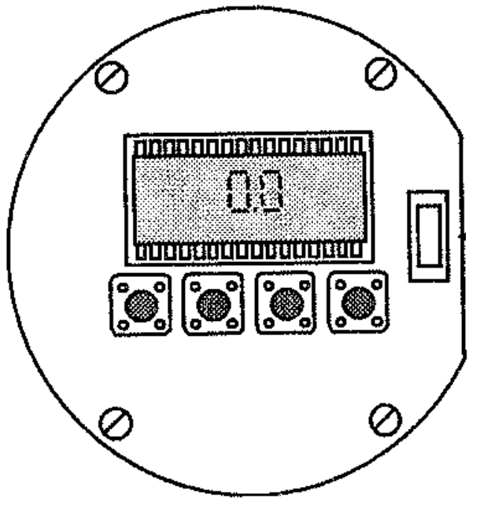
Dynament MSR Sensor
Negative / Positive zero suppression:
These sensors drift and therefore they require a suppression function which enables the sensor to output 0ppm until it crosses the set suppression threshold. For example if threshold set at 10 ppm, sensor will read 0 ppm from 0-10 ppm.
Negative suppression works similarly in that until it goes below say -10 ppm in output the sensor will show 0 ppm.
Error Codes flash on normal LCD screen replacing reading for 2 seconds.
Code # | Issue
2 | Negative drift, adjust negative suppression
4 | Zero the sensor as the sensor is too far outside of negative suppression
8 | Sensor needs to be gain calibrated
16 | Calibrate sensor, if error still occurs replace sensor cell if possible.
32 | Calibrate sensor, if error still occurs replace sensor cell if possible.
64 | Sensor signal too high, attempt calibration and replace if it doesn’t work
99 | Config. data corrupt, attempt power cycle and recalibration if possible
Menu
Enter
Next
Prev

Slide 27
Dynament MSR Negative Suppression
Step 1:
Press Menu key navigate to option E:20 using next /prev keys and press enter.
Step 2:
Use the next and prev keys to increase and decrease the negative suppression (0-10% OF RANGE)
Step 3:
Press enter to save the negative suppression value.
Menu
Enter
Next
Prev

Slide 28
Dynament MSR Positive Suppression
Step 1:
Press Menu key navigate to option E:19 using next /prev keys and press enter.
Step 2:
Use the next and prev keys to increase and decrease the negative suppression (0-10 % OF RANGE)
Step 3:
Press enter to save the negative suppression value.
Menu
Enter
Next
Prev

Slide 29
Dynament MSR Calibration
Step 1:
Press Menu key navigate to option E:1 using next/prev and press enter
Step 2:
Apply zero gas for 30sec to 1 min. Press enter to zero.
“- - - -” WILL BE DISPLAYED IF ZERO IS SUCCESSFUL
Menu
Enter
Next
Prev

Slide 30
Dynament MSR Calibration cont.
Step 1:
Press Menu key navigate to option E:2 using next/prev and press enter
Step 2:
Apply gain gas for 30sec to 1 min.
Step 3:
Use next/ prev buttons to increase / decrease the reading till the concentration reaches the gain gas concentration.
Step 4:
Press enter to complete calibration.
“- - - -” WILL BE DISPLAYED IF GAIN CALIBRATION IS SUCCESSFUL
Menu
Enter
Next
Prev

Slide 31
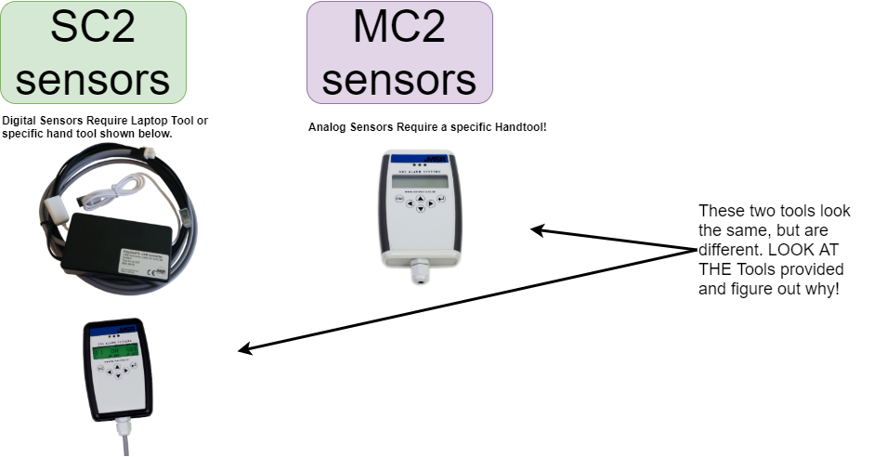
Sensor Info

Slide 32
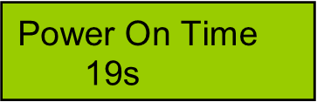
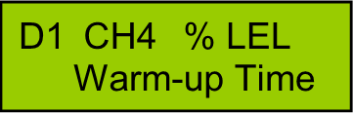




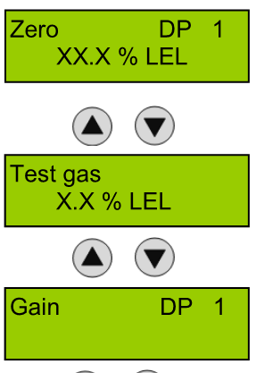
MSR MC2 “Analog” Sensor Calibration
Step 1: Apply Service mode (Inhibit alarms on the controller)
Step 2: Wait for power on time / warm-up Time to finish and navigate to
“Installation & Calibration” -> “Calibrate” -> “DP 1”
Step 3: Apply zero gas to sensor (wait 30 seconds) & go to “Zero calibration” menu.
Step 4: Hit enter , if calibration is accepted “Saved” will appear on screen.
Step 5: Navigate to “Test gas” and enter “Gain DP 1”
Step 6: Hit enter , if calibration is accepted “Saved” will appear on screen.

Slide 33

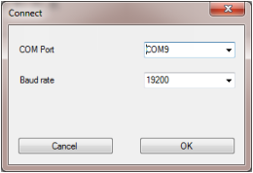
MSR SC2 “Digital” Tool Operation
USB drive should be detected, if not call ALVI / Sandeep for troubleshooting.
Open PCE06-XXX-XXXX.exe file
Plug the PC tool into your laptop.
Select Comm port
Click Connect
Enter Password for software
“8304”

Slide 34

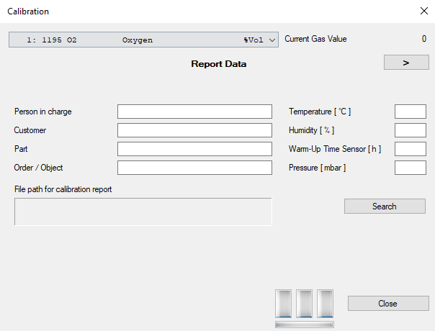
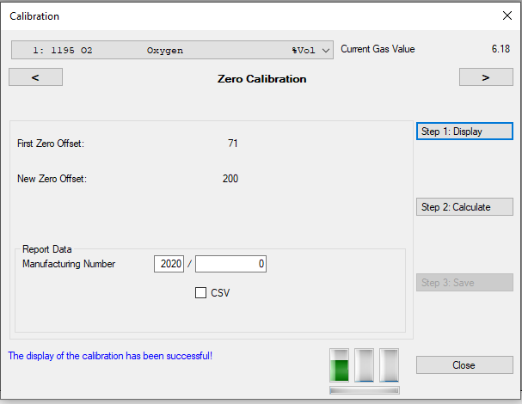
MSR SC2 “Digital” Sensor Calibration
Step 1:
Before making any changes special mode or service mode must be activated
Step 2:
Engage Calibration Mode by clicking this icon.
Step 3:
Fill In Calibration Details and select sensor.
Step 4:
Hit the arrow key at top right corner
Start Zero Calibration:
Apply zero cal gas
Click Display
Wait 30 seconds
Click Calculate
Click save once sensor reading has stabilised

Slide 35
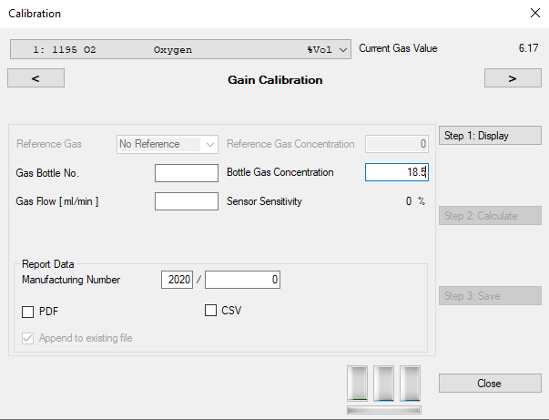
MSR SC2 “Digital” Sensor Calibration cont.
Step 5:
Hit the arrow key at top right corner to progress on to gain calibration.
Enter Bottle Gas Concentration.
Apply gas
Click Display -> Calculate -> Save
Allow enough time for calculation, some sensors require upwards of 1 minute in order to complete

Slide 36
Sensitron Sensor Calibration (Tool Required)
Step 1:
After you plug in the calibration keypad, after displaying the software version. The module will display the enter password menu.
“0000”
Using up and down enter pass: “0261 “
Step 2:
If password entered correctly “Cal” will be displayed.
Hit Enter
“Zero” will be displayed

Slide 37
What is the difference between Digital and Analog?
Lets list some advantages and disadvantages
Digital Sensors!
Very Accurate
Very easy to calibrate
Figuratively cannot fuck it up! ☺
Most modes of failure can have an error code ie if there’s an error in the sensor cell it will give a different error code to comms failure.
Analog Sensors!
Difficult to calibrate, require adjustment of input and output
Multiple points of failure only one level of response in terms of error reporting sensor just goes underrange when in error.

Slide 38

PG2 Topics Covered
SC2 & MC2 calibration
SC2 & MC2 Calibration
SC2 & MC2 Troubleshooting
Common Nomenclature
Easy Config Basic UI explanation
Logging
Controller config files
Types of Bus Connections explanation(L BUS , F BUS, M BUS)
Calibration
GC-06 Config
Parameters Config
Analog Output / Analog input calibration
Troubleshooting Errors
Wiring Configurations for BUS
SB2 & MSB2
Addressing SB2 + PARAMETERS FOR DGC BUS
Addressing MSB2 + PARAMETERS FOR DGC BUS
Addressing SB2 for Modbus output
Addressing MSB2 for Modbus output
MSB2 Analog output (Remote)
EP-06 Config
Parameters config
Analog Output (Remote)
Troubleshooting Errors
Modbus Setup
Modbus Version Check: How to
Modbus Addressing
Technical Specifications of Modbus output
Baud, RS 485
Modbus Poll Verification, How to:
BacNET GATEWAY addressing
DEM-06 Config and Features

Slide 39
Common MSR Sensor System Error Codes
Error Code | Hints
9000 | Wiring issue or communication issue between controller and sensor or sensor and sensor board.
8001 | UPS Issue, check the voltage being delivered from the power supply, ensure it is below 25 VDC
8100 | Sensor is under range Calibration issue (just zero and gain calibrate again) Check programming to make sure you’ve programmed the correct sensor (digital / analog)
8200 | Sensor is over range Calibration issue (Sometimes LEL sensors go over range, just perform a zero calibration and gain calibration) Power issues can cause over range signal due to the fuse resistor being burned out.
8002 | Sensor ADC error Sometimes the controller will show 0X8200 error and if you plug into the sensor it will show 0x8002. This is a warranty issue, replace and move on.
8001 | Sensor EE error Sometimes caused by programming (double check) otherwise replace.
8020 | I/O Error -Programming / Analog output interface error.

Slide 40
SC2 & MC2 Sensor Calibration
Basic Overview
MC2 Handtool LED Indicators
Sample Power on Times:
CO2
30 Seconds
Refrigerant
180 Seconds
CO
8 Seconds
Oxygen
10 Seconds
Yellow light flashing
Fault / Power on time
Best way to check is to read measuring values
Green light
Power on
Red Light
Alarm situation
Insert Tool into SB2 OR MC2 PINS
Wait for Power on time to finish
Zero calibration first
Gain Calibration afterwards

Slide 41
SC2 & MC2 Troubleshooting
Reading Operating Data
Must Use EASY Config tool for this
Connect SC2 OR MC2 to SB2 OR MSB2
Read Operating Data (This gives you information on usage of sensor)
Max Operating Temp
Min Operating Temp
Can Use this info to determine warranty outcome
Common Wiring Issues
Overrange
Incorrect Wiring
Underrange
Requires re-calibration (Most prevalent in LEL)
Common Troubleshooting methods:
Incorrect wiring for long periods can cause damage to Analog board on MC2.
3 pin MC2 connection does not work for MC2 HAND TOOL then sensor is dead.

Slide 42
Common Nomenclature
AP = ANALOG SENSOR MEASURING POINT
DP = DIGITAL SENSOR MEASURING POINT
AR / PR = Relays inside control cabinet
SR = Signal Relays in the field on field devices
SB = Sensor board
MSB2 = Multi Sensor Board
MSC2 = Multi Sensor Controller
MGC2 = Multi Gas Controller
SC2 = Digital Sensor head
MC2 = Analog Sensor head
PG2 = Polygard 2
PX2 = PolyXeta 2 Hazardous Area system
AO = Analog Output
FBUS = Field Bus
MBUS = Main Bus
LBUS = 3 wire bus
MODBUS = Industry standard comms developed by Schneider over IP/RS485
BACNET = Industry standard comms over IP/RS485
BAUD RATE = baud rate is the rate at which information is transferred in a comms standard
Comm port = Communication port on your computer

Slide 43
Types of Comms Native to PG2 SYSTEMS
Field bus
What communicates on this bus?
EP
SB
MSB2
MSC2
MGC2
Special Features
DGC-06 proprietary bus
4 wire bus or 2 wire RS485 assuming common ground
Baud rate 19200
Based on MODBUS
L-BUS
What communicates on this bus?
SC2
Remote board
Special Features
3 Wire bus Not much known by us about this bus
Suspect it is MODBUS 3 wire
M-BUS
What communicates on this bus?
GC-06 ONLY!
NOT READY YET!!
Special features (yet unknown)
Communications between two separate systems which can then communicate via HLI to Modbus only requiring connection to 1 system ( refer to Fig 1.1).
Most likely a 4 wire bus
SYS1
HLI connection to Building Management System
M-BUS connection between systems
SYS2
SYS3
SYS4
Fig 1.1 (M-Bus example)

Slide 44

DGC-06 HLI Outputs available
BACNET
BACNET Modules communicate with GC-06 on a MODBUS connection therefore two things are required for BACNET Modules to work. A Modbus capable controller + BACNET Module
Limitation:
Because of address limitations BACNET module can only output the following:
Modbus
Easiest and most cost effective solution for HLI comms output for our system to BMS.
Limitations:
None
All system parameters are available for viewing via Modbus output.
Fig 1.2 (BACNET Module configs)

Slide 45
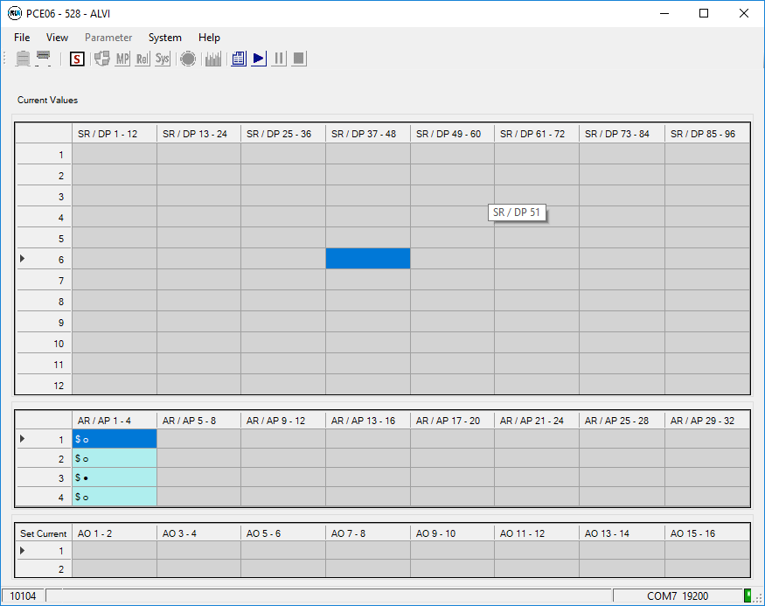
Easy Config Basic UI
Datalogging Toolbar
Full explanation later
Tool Number: Please note this should match the physical tool you’ve been provided.
Operating Data
System Parameters
Connect / Disconnect: Connects / disconnects to device that is plugged into tool.
Relay Parameters
Measuring Parameters
Addressing Menu
Software Ver. Of Device Connected
Digital Sensors + Signal Relays 1-96
Comm Port used to connect & Baud Rate
Analog Sensors + Analog Relays 1-32
Connection status Green = good
Analog Outputs from GC/SB/MSB/EP
Fig 1.3 (Easy Config UI)

Slide 46
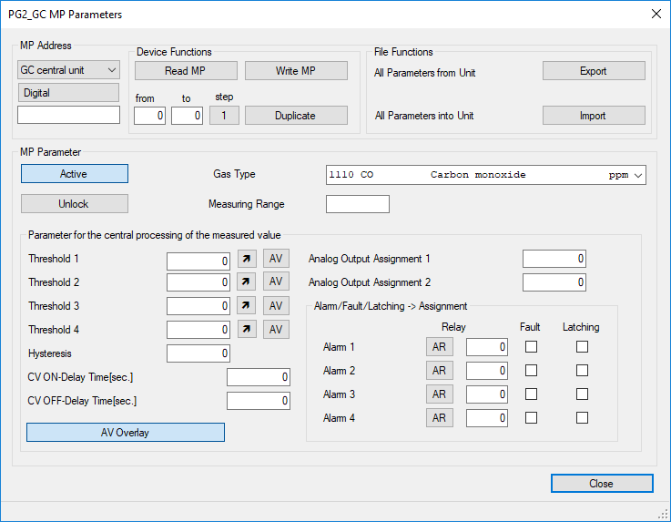
Measuring Parameters
Measuring Parameters
Very Similar to OLD DGC-05 easy config page.
New Features Highlighted in fig 1.4
Latching Function works differently in GC-05.
Eg: If alarm 4 latching, then automatically Alarm 1-4 are all latching
Fault function for Alarm
Eg: If fault exists Alarm 1 ON MP XX will trigger relay XX
Toggle to select AR / SR (digital or analog relay)
Fig 1.4 MP CONFIG
Toggle to select AR / SR (digital or analog relay)

Slide 47
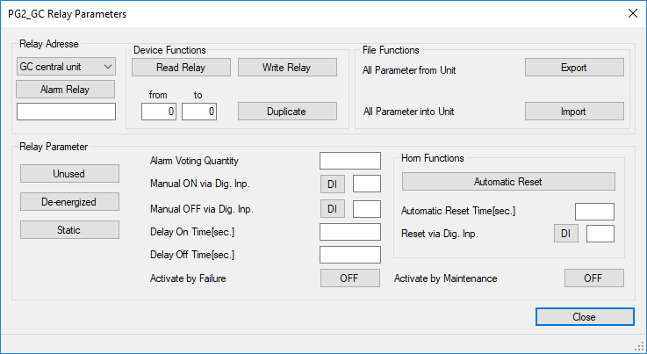
Relay Parameters
Relay Parameters
Very Similar to OLD DGC-05 easy config page.
New Features Highlighted in fig 1.5
Activate by Maintenance (Unknown or unimplemented)
Alarm Voting Quantity:
EG: Relay will only activate if 2 or more (based on number quantity input) separate alarms assigned to this relay are in alarm.
Fig 1.5 Relay CONFIG
Activate by Failure (Unknown or unimplemented)

Slide 48
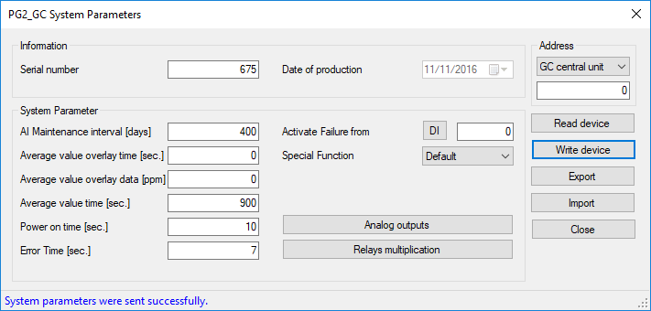
System Parameters
System Parameters
Very Similar to OLD DGC-05 easy config page.
New Features Highlighted in fig 1.6
Special Function:
Title 24 / Default
Title 24 is a US regulation, that is not useful to us.
Maintenance interval function not implemented.
Fig 1.6 System CONFIG
Activate Failure from (Unknown or unimplemented)
Error Time (Sec) not implemented yet.

Slide 49
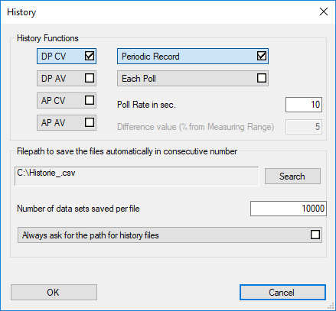
Logging setup
Logging setup
Very Similar to OLD DGC-05 easy config page.
New Features Highlighted in fig 1.7
Logging options:
Digital Sensors
Analog Sensors
Fig 1.6 System CONFIG

Slide 50
Wiring Configurations for F-BUS

Slide 51
Practical Exercises
Programming Sensors
Programming Relays
Calibrating Sensors
Analog Output programming
Analog Output Programming GC TO EP
Analog Output Programming SB TO GC
Analog Output Programming SB TO MSB2
Logging Sensors
Hand tool calibration
PG2 Handtool
MC2 Handtool
PX2 Sensor calibration
PX2 Sensor Relay programming
Modbus Addressing
Modbus version check
Modbus Poll Check

